Slide 1
Digital Signal Processing of Acoustic Emission Signatures of good and lop
Welded Defects Of Nuclear Grade Material Using MATLAB
By
Sri Surya Sameer (11B91A04B5)
Under the guidance of
Dr.S.V.Ranganayakulu

Slide 2
Overview
Welded Defects & Acoustic Emissions in context of DSP
Defining Acoustic Emissions
Block Diagram
Procedure Employed
Software & Hardware Tools Used
Results
Justification
Applications

Slide 3
Welded Defects
Pinhole
Slag
GOOD
Lack of Penetration
Lack of Fusion
Porosity
Toe Crack
Root Crack

Slide 4
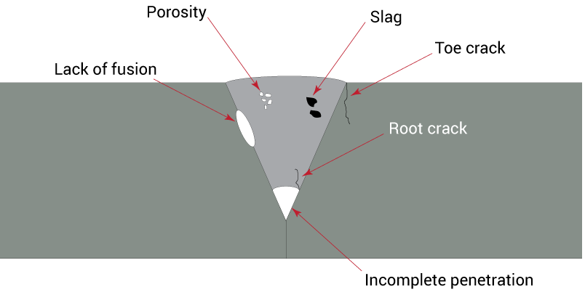
Welded Defects

Slide 5
PINHOLE Welded Defect
Pinholes" refers to a welding defect caused by high welding temperatures.
If the temperature of the arc making the weld is too high, tiny holes resembling pinholes may appear on the surface of the weld.

Slide 6
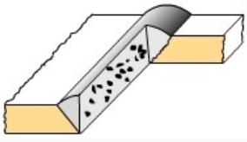
SLAG Welded Defect
Slag inclusions refer to non-metallic solids trapped in the weld deposit or between weld metal and base metal
These inclusions may be present as isolated particles or as continuous or interrupted bands.
Slag inclusions are not visible unless they emerge at surface.

Slide 7
Acoustic Emissions
Acoustic Emission (AE) is the study and practical use of elastic waves generated by a material subjected to an external stress.
Acoustic emission, then, is the generation of an elastic wave by the rapid change in the stress state of some region in the material.
Acoustic Emission is used to classify & differentiate defects in welded material.

Slide 8
Welded Defects & Acoustic Emissions in context of DSP
We have exploited concepts of digital signal processing in analysis of welded defect
The DSP mode of analysis is used differentiate various parameters
This can finally be used as a tool in analysis various welded defects so that quality of structures can be ensured and thus the safety of bridges, aeroplane structures, nuclear reactors

Slide 9
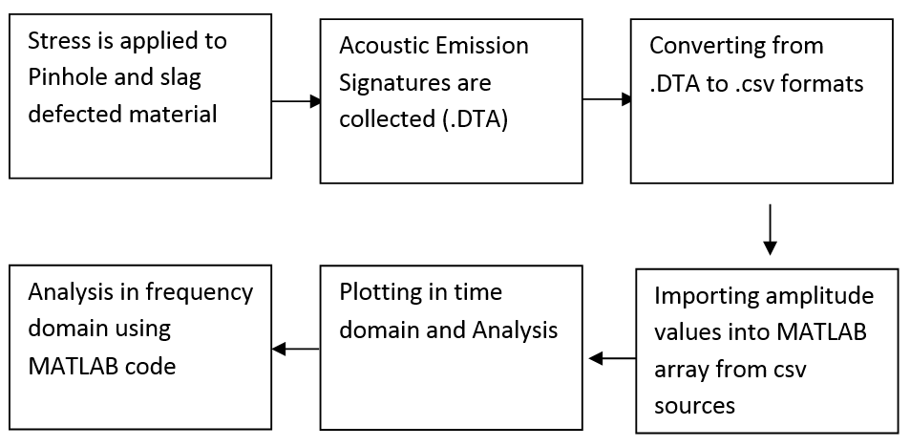
Block Diagram

Slide 10
Procedure(Brief Description)
Sample to be tested is chosen which is either the GOOD sample or sample with Lack of Penetration (LOP) welded defect
The Acoustic Emission(AE) sensors are placed on the either sides
Force is applied on the material using the mechanical jig shown
The crack break opens giving rise to acoustic waves which are sensed by the Acoustic Emission (AE) Sensor in form of electrical impulses
A huge amount of data is generated in .csv formats around 100-200 files and each file may contain around 600-700 readings.
These amplitude values are now anlysed in time & frequency domains

Slide 11
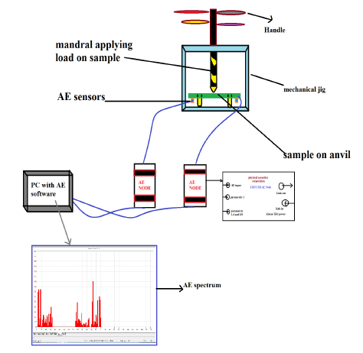
Various Interconnections

Slide 12
Hardware Tools
Mechanical Jig
USB Acoustic Emission Sensors
Acoustic Node
Personal Computer

Slide 13
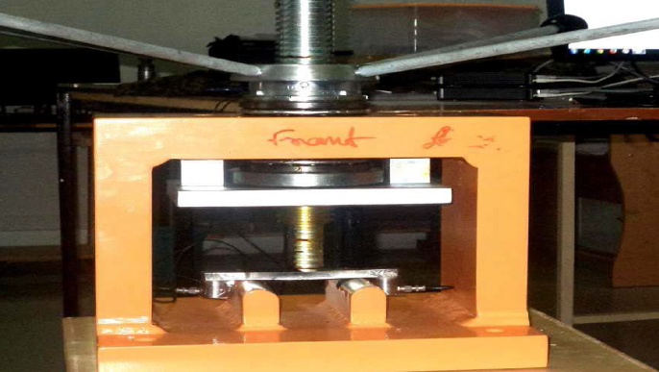
Mechanical Jig (Patented)

Slide 14
USB Acoustic Emission Node
Basically its an A/D Converter
The USB AE Node is a single channel Acoustic Emission (AE) Digital Signal Processor
Through the USB Connector, the AE Node is easily interfaced to a Notebook or PC running Windows 7, 8

Slide 15
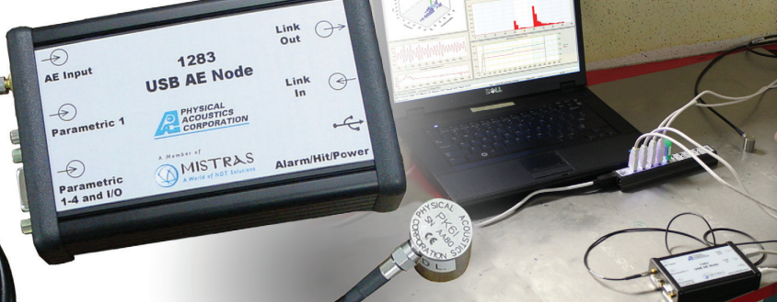
USB Acoustic Emission Node

Slide 16
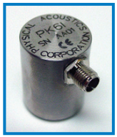
Sensors (PK6I Acoustic Sensor)
Characteristics
medium frequency resonant
acoustic emission sensor
ultra-low noise, low power
filtered
26dB preamplifier

Slide 17
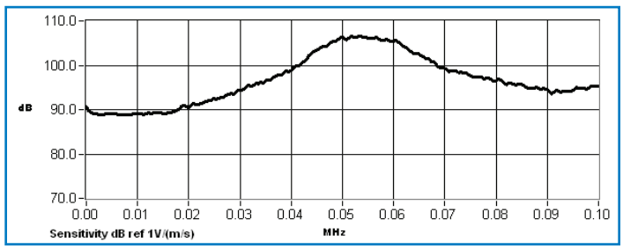
PK69I Sensor Response (Megahertz Scale)

Slide 18
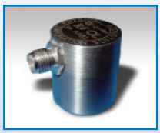
Sensors (R6α Sensor)
Characteristics
This sensor has as Peak Sensitivity 75dB
Operating Frequency Range is 35 - 100 kHz with Resonant Frequency 55 [90] kHz.
This sensor can be used on metal and FRP structures such as pipelines or storage tanks in petroleum, refineries, chemical plants

Slide 19
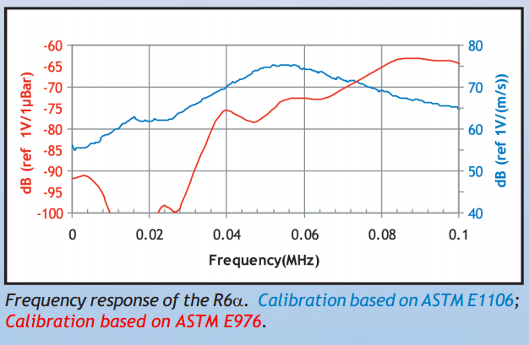
R6α Sensor Response (Megahertz Scale)

Slide 20
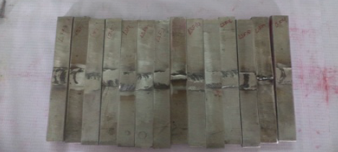
Welded Defect Samples

Slide 21
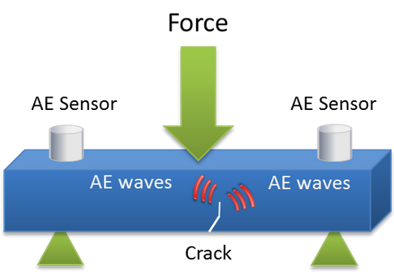
Acoustic Emission Detection

Slide 22
MATLAB
MATLAB (matrix laboratory) Developed by MathWorks,
MATLAB allows matrix manipulations, plotting of functions and data, implementation of algorithms, creation of user interfaces
Interfacing with programs written in other languages, including C, C++, Java, and Fortran.

Slide 23
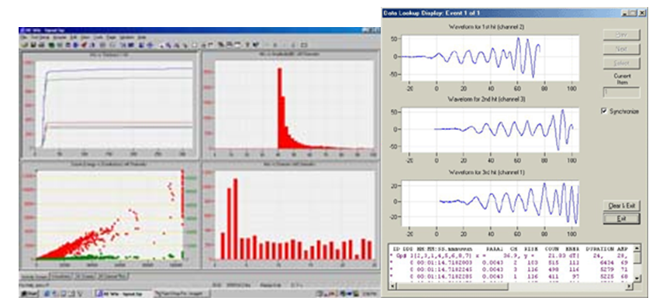
AE Win
Used for Interfacing Acoustic Sensors to Computer
Coverting .DTA to csv

Slide 24
Results
Time Domain Results
Frequency Domain Results

Slide 25
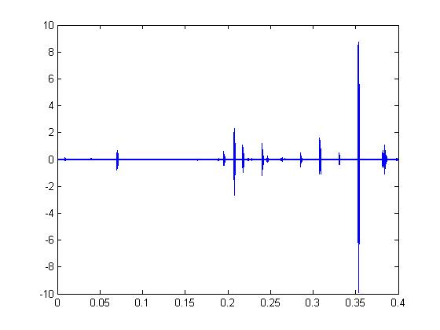
Time Domain Plot(PINHOLE Sample )

Slide 26
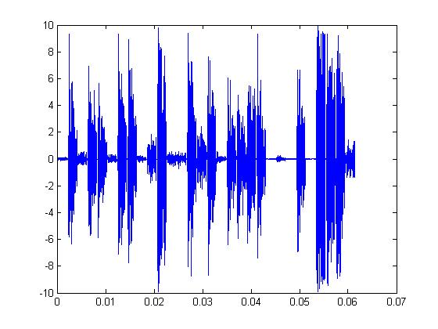
Time Domain Plot(SLAG Sample)

Slide 27
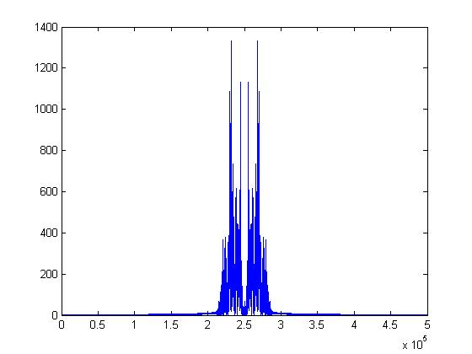
Frequency Domain Plot(PINHOLE Sample )

Slide 28
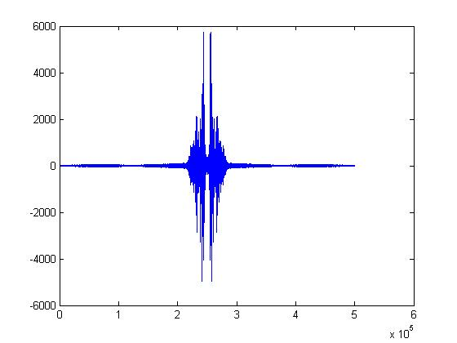
Frequency Domain Plot(SLAG Sample )

Slide 29
Conclusion
PINHOLE sample has fewer burst emissions than SLAG
The dominant frequency gain domain differs
Thus various defects can be classified in the same way

Slide 30
Applications
Gas trailer tubes
Bridges
Aerospace Structures
Medical Application

Slide 31

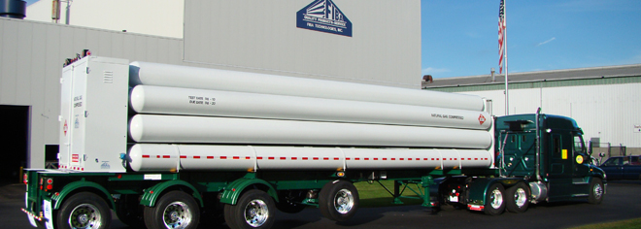
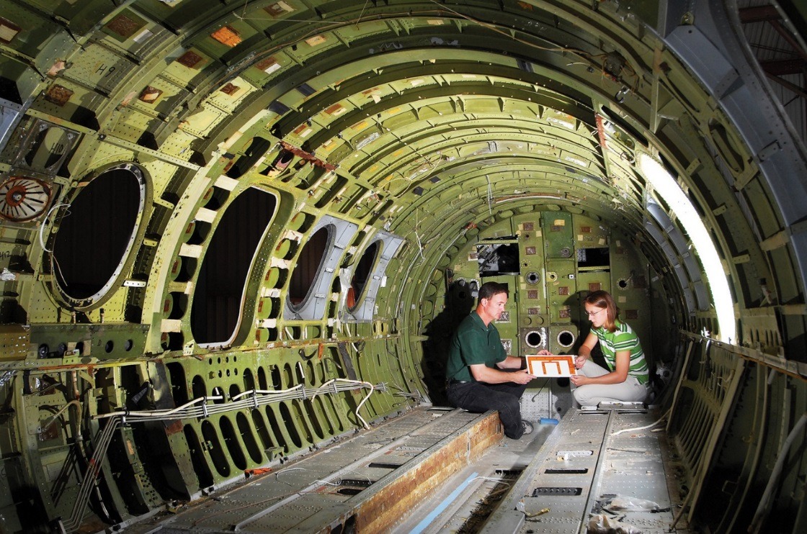
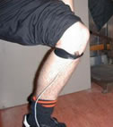
Summary of Applications

Slide 32
References
1. Acoustic Emission Studies on Weld Bead Defects in Nuclear Grade SS 316L Materials by Dr.S.V.Ranganayakulu Sir.
2. Kaiser, J. “Untersuchungen uber das Auftreten Gerauschen beim Zugversuch. (A Study of Acoustic Phenomena in Tensile Tests).” Ph.D. Thesis. Technische Hochschule of Munchen. Munich Germany, 1950.Translated UCRL-Trans-1082(L).
3. Cady, W.G. Piezoelectricty, Vol. 1 & 2. Dover Publications, NY and W.P. Mason. “Piezoelectric Crystals and Their Application to Ultrasonics.” D. van Nostrand Co. Princeton. 1950.
4. Bell, D. A. “Noise,” in Handbook of Electronic Engineering, L.E.C. Hughes and F.W. Holland, Chemical Rubber Co. Cleveland OH, 1967.

Slide 33
Thank You

